Slide 1
IoT - Concepts and
Applications
IoT: Wiring the World, One Device at a Time

Slide 2
IoT Industry
Watch a Tesla factory in Berlin and think of the following
Scale and Connectivity: "Imagine you're responsible for setting up and maintaining the network infrastructure of a factory of this size. What are the immediate challenges that come to mind?"
Automation Focus: "Beyond basic connectivity, what specific types of network technologies do you think are needed to support all the robotics and automated systems you might see in a factory like this?"
Data in Motion: "We know IoT systems generate a lot of data. Think about the different kinds of data that might be collected in a car manufacturing process, and how networks play a role in getting that data where it needs to go."

Slide 3
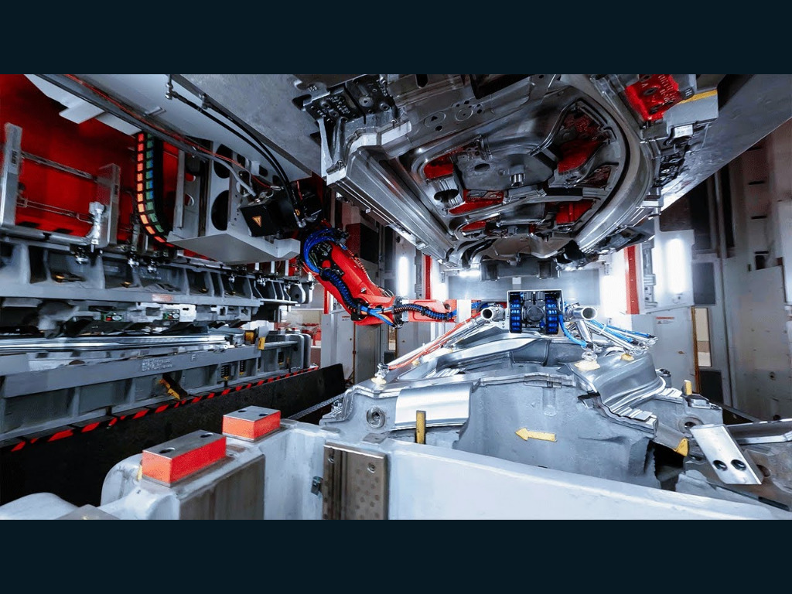
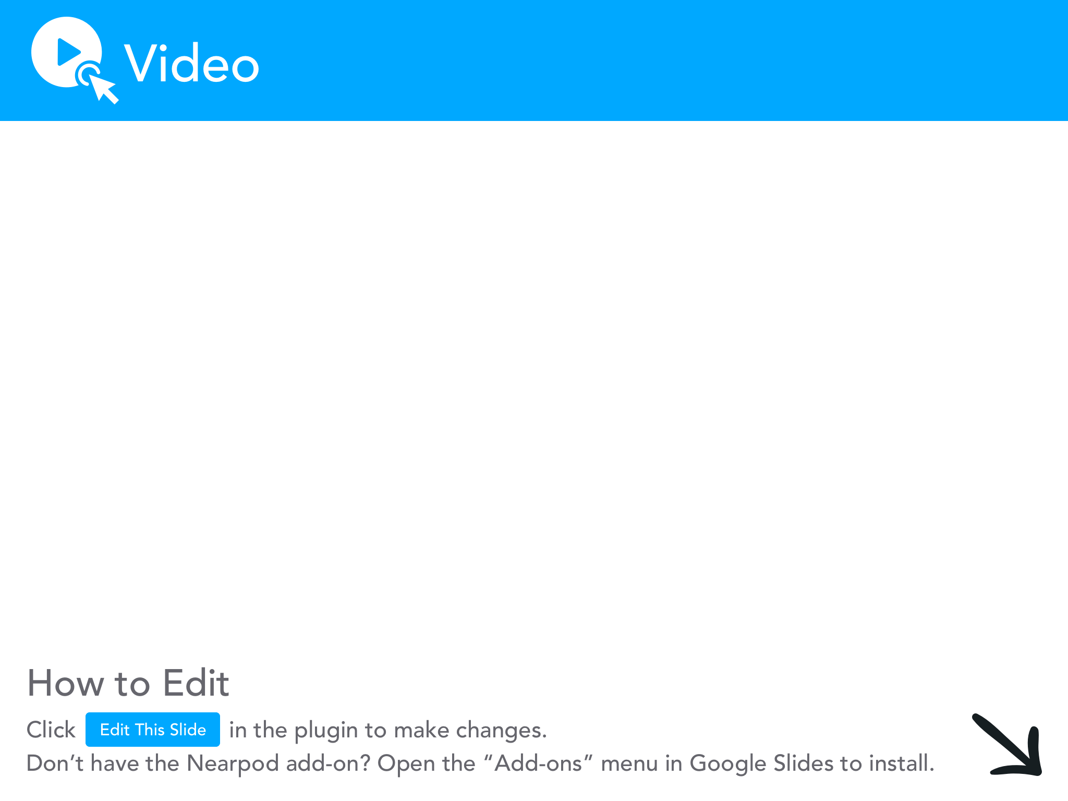

Slide 4
Define IoT
The Internet of Things, or IoT, refers to the vast network of physical objects – devices, vehicles, appliances, you name it – that are embedded with sensors, software, and connectivity that enables them to collect and exchange data over the internet.
Key point: It's not just about the objects, it's about the network that connects them. This network enables data collection, remote control, and automation.

Slide 5
Brief History
Early Days: The idea of connected devices dates back decades. Think about things like RFID tags for tracking inventory or simple sensors in industrial settings.
The Rise of Connectivity: Widespread availability of affordable internet connections and powerful, but small, computing devices fueled the growth of IoT.
Cloud & Data Revolution: Cloud computing and advances in data analytics made it possible to handle massive amounts of IoT data and turn it into meaningful insights

Slide 6
Key IoT Components: Sensors and Actuators
Sensors: Devices that detect changes in the environment (temperature, light, motion, pressure, etc.) and convert them into electrical signals.
Actuators: The "doers." They take electrical signals and cause a physical action (turn on a motor, switch a light, etc.).
Example: A temperature sensor in a smart thermostat detects a drop in temperature, triggering the actuator (furnace) to turn on.

Slide 7
Key IoT Components: Embedded Systems
These are small, specialized computers within devices that control the sensors, actuators, and process data. Think of them as the 'brains' of an IoT device.
Microcontrollers vs. Single-board:
Microcontrollers: Very basic, ideal for simple IoT tasks (think Arduino).
Single-board Computers: More powerful (like Raspberry Pi), can run more complex software.

Slide 8
Key IoT Components: Connectivity Protocols
Wi-Fi: Common in smart homes, power consumption is a factor.
Bluetooth/BLE: Ideal for short-range, low-power devices (wearables).
Zigbee/Z-Wave: Designed for low-power, mesh networks common in smart home automation.
Cellular (LTE-M / NB-IoT): For long-range, low bandwidth needs (remote sensors).

Slide 9
Key IoT Components: The Cloud's Role in IoT
Even a single IoT device generates a lot of data
Multiply this by large networks of devices
Cloud provides scalable storage and processing power
Enables remote control and automation

Slide 10
Key IoT Components: Cloud Services for IoT
Device management tools
Data processing and analysis pipelines
Pre-built solutions for common IoT use cases

Slide 11
Key IoT Components: Connected Car Example
Sensors collect driving data, system health, location
Cellular network transmits data to the cloud
Cloud analysis for safety improvements, efficiency tips, predictive maintenance

Slide 12
Understanding IoT Architecture
Layer 1: Devices & Sensors ("Things")
Layer 2: Network & Gateways
Layer 3: Cloud/Applications

Slide 13
Layer 1 - The "Things"
Sensors gathering data about the environment
Actuators that carry out actions
The embedded systems and microcontrollers that control them

Slide 14
Layer 2 - The Network
Diverse Protocols: Wi-Fi, Bluetooth, Zigbee, Cellular serve different IoT needs
Power vs. Range: Balance power consumption and transmission distance
Data in Two Directions: Data flows to the cloud AND commands back to devices
Management Challenge: Ensuring security and reliability across diverse networks

Slide 15
Layer 3 - Applications
Data is stored and analyzed on a large scale.
Applications make use of this data (controlling devices, providing insights to users)

Slide 16
Example: Smart Thermostat
Device: "The thermostat has a temperature sensor."
Network: " It connects to your home Wi-Fi. A gateway (probably built into your router) handles that data transfer."
Cloud/App: "The thermostat data goes to the manufacturer's cloud platform. Their app lets you control it remotely and may even analyze your usage patterns to optimize heating/cooling."

Slide 17
Wi-Fi in IoT
Common in smart homes and offices
Offers good bandwidth for data-intensive devices (cameras, streaming)
Power consumption is a consideration

Slide 18
Bluetooth & BLE in IoT
Bluetooth Low Energy (BLE) optimized for wearables, beacons
Short-range, ideal for device-to-device communication
Focus on power efficiency

Slide 19
Zigbee & Z-Wave in IoT
Designed for low-power, low-bandwidth home automation
Mesh networking: Devices relay data, extending range
Ideal for sensors, smart lights, etc.

Slide 20
Cellular in IoT
Long-range, doesn't require existing Wi-Fi
LTE-M / NB-IoT: Standards designed for low-power IoT devices
Use cases: Remote sensors, asset tracking, connected vehicles
IoT on the Go

Slide 21

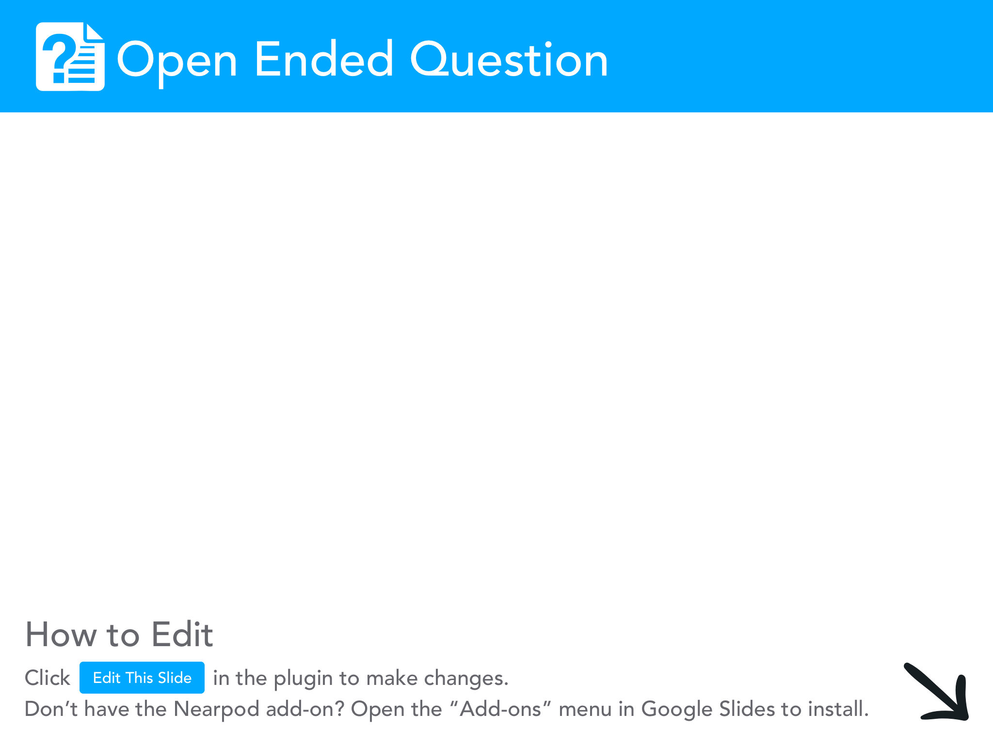

Slide 22
Smart Manufacturing
Network Protocols: Which are used (wired, wireless) and why? Consider reliability and low latency needs on the factory floor.
Data Management: The massive scale of real-time data - storage, edge computing, dashboards.
Security: Vulnerabilities posed by IoT devices on a production network. How to mitigate?

Slide 23
Network Management
How do you monitor hundreds or thousands of IoT devices on your network?
How can automation make configuring and updating all those devices less painful?
Can IoT-enabled intrusion detection add a new layer of security to your network?

Slide 24
Smart Homes & Cities
The backend infrastructure of a truly smart city (sensor networks, fiber, data centers)
Privacy and data governance challenges at this scale
Large-scale network segmentation strategies to secure critical infrastructure mixed with public-facing IoT.

Slide 25
Healthcare
What are the unique security risks of medical IoT devices compared to, say, a smart thermostat?
Think about strategies for protecting patient data and ensuring device reliability
Strict compliance requirements in the healthcare industry and how they impact system design.

Slide 26
IoT and the Future of Jobs
Programming and Data Analysis: To build and manage IoT systems
Security Expertise: Securing IoT devices and networks is paramount
Network Management: The sheer number of connected devices requires strong network skills.

Slide 27
Break 10 minutes
However!!
When we return, search the Internet for IoT breaches, and how they’ve been used in large scale attacks.

Slide 28
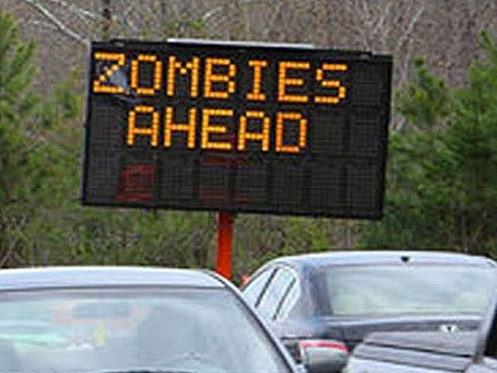

IoT Security: A Systems Admin's Nightmare?
Default credentials are the best!
I live on the edge, always use authentication without TLS.

Slide 29
Security Best Practices
Network Segmentation: Isolating IoT devices on separate VLANs to limit attack spread.
Strong Device Management: Tools for provisioning, updating, and monitoring IoT device security.
Patch, Patch, Patch: Updates for IoT devices.
Zero Trust Approach: Not inherently trusting any device on the network

Slide 30
Scalability Challenges
Monitoring a massive number of diverse devices
Automating updates and configuration changes across hundreds/thousands of devices
Tools and protocols specifically designed for IoT device management at scale

Slide 31
Data: The Double-Edged Sword
Where do you store this data? Consider cost vs. speed of access needs.
Edge Computing: When does it make sense to process data locally vs. sending everything to the cloud?
Data-Driven Decisions: Value of IoT data, but only if it can be managed effectively

Slide 32
Exercise
See the provided Wireshark capture on the course site
What traffic can you seee? Is it encrypted? Can you determine what the device is? How?

